Slide 1
Computers and Computer Systems

Slide 2
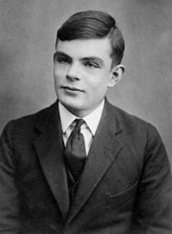

Who is he?
Notes:
Alan Turing: computer scientist, mathematician, logician, cryptanalyst, philosopher...general purpose computer
Universal Turing machine/Universal Computing Machine
Stored-program electronic computers

Slide 3
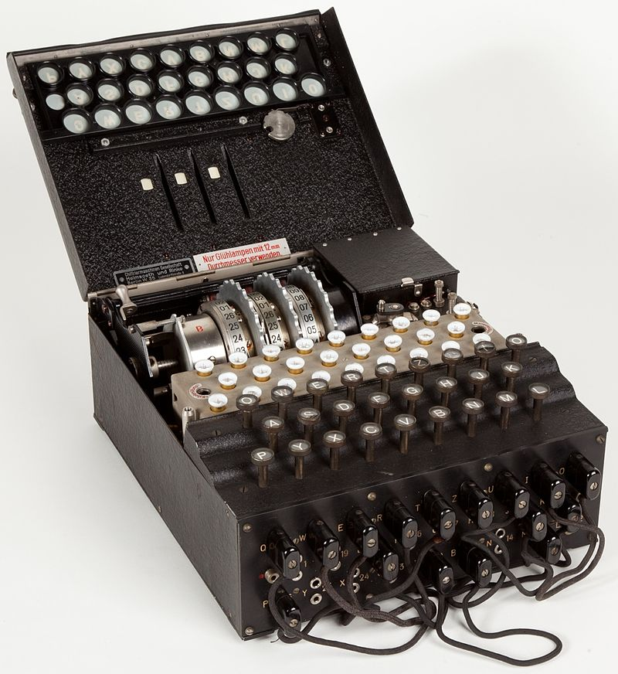
Enigma machines
Electro-mechanical rotor cipher machines
Enigma
https://www.youtube.com/watch?v=J46hu4RMB5I

Slide 4
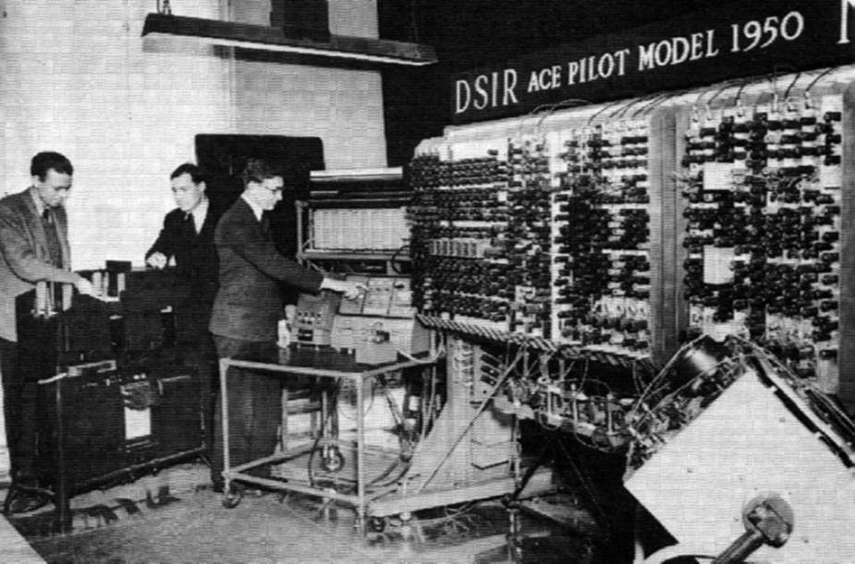
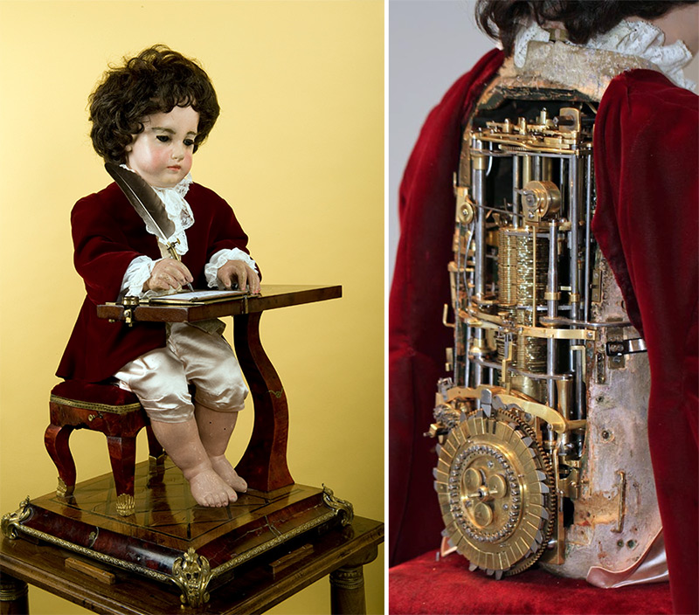
General-purpose vs. special-purpose
Pilot ACE (Automatic Computing Engine)
18 century ‘the Writer’ Automaton
https://www.youtube.com/watch?v=bY_wfKVjuJM
Initial design in 1945; ran first program 1950.

Slide 5
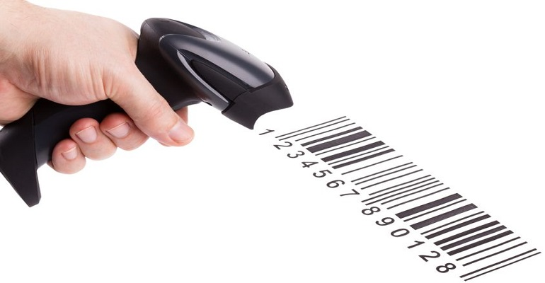
Introduction
Can you describe what a computer looks like?
What does a computer do?
What products incorporate “invisible” computers?

Slide 6
ENIAC
Electronic Numerical Integrator And Computer
For general purpose
https://www.youtube.com/watch?v=k4oGI_dNaPc
Mathematical operations
Addition, subtraction, multiplication, division
What is the square root of 16?
Notes:
/iniac/

Slide 7
2 Computers and computer systems

Slide 8
A system
Input
Process
Output
Feedback

Slide 9
Computer systems
Map the items on Figure 2 in Page 10 with the related categories
Computer
Hardware
CPU
Main memory
Software
Peripherals

Slide 10
Peripherals
Peripherals
Storage devices (secondary memory)
Printer
Input/output devices
Disk drives
Monitor
Router

Slide 11
Storage
Magnetic storage
Optical storage
Flash memory

Slide 12
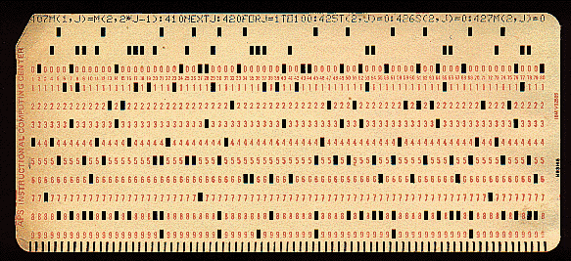
Before floppy drives…
Single-sided 8” floppy holds 80K = 3,000 punch cards
The history of computer storage: https://www.youtube.com/watch?v=-KRLWGaIunA

Slide 13
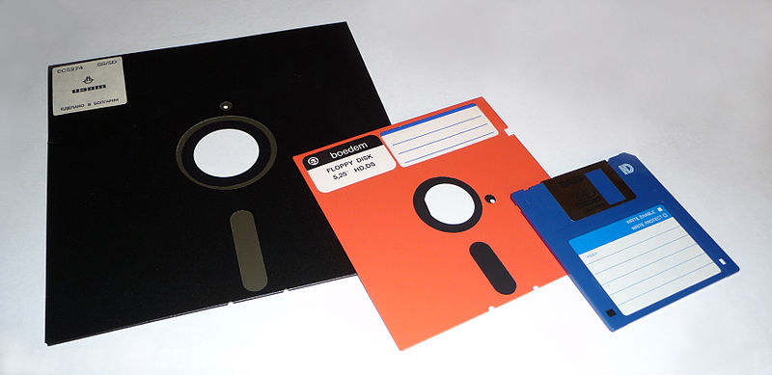
The floppy disk family: 8”, 5.25” and 3.5”

Slide 14
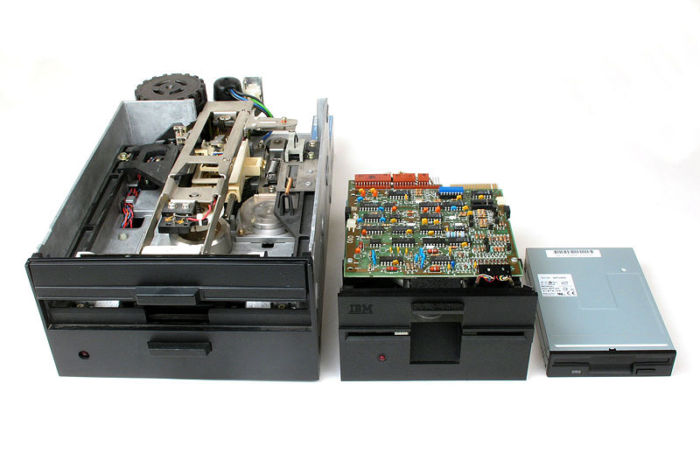
Which of these drives did you own?

Slide 15
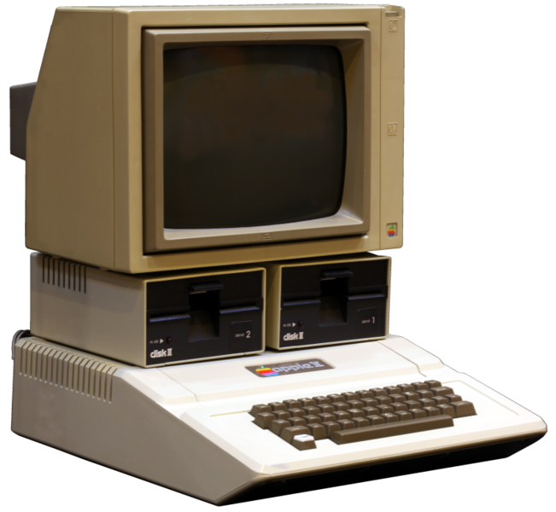
1977's Apple II

Slide 16
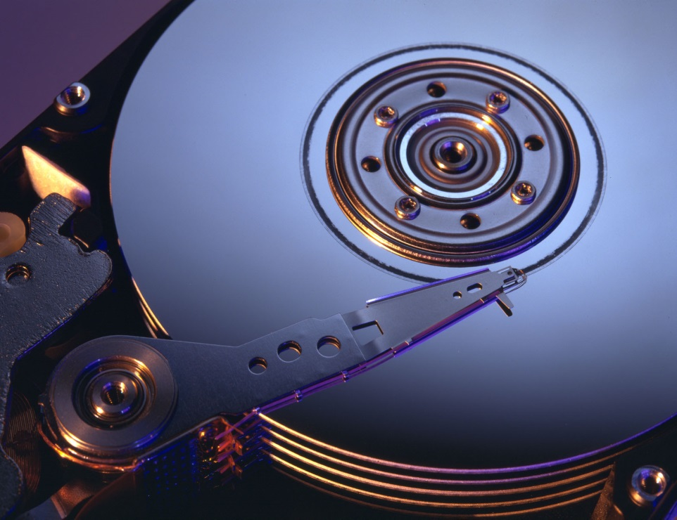
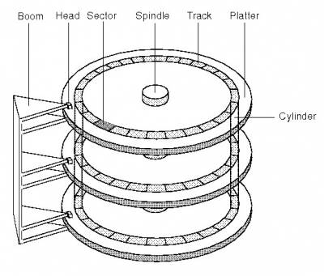
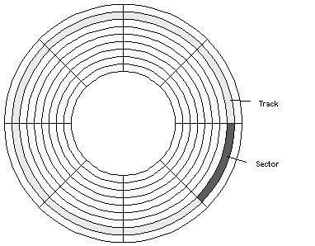
Hard disk

Slide 17
Assignment I
What products/devices do you use everyday that contain processors?
Filename: [YourStudentId_assignment1.docx, .txt or .pdf]
Upload to ftp:\\163.25.117.117\ckuo_upload\ScientificEnglish\AssignmentI
After ftp:\\163.25.117.117 log on to the system using ID temp and password temp
After seeing ckuo_upload folder, fine the correct folder
Deadline: Wednesday, 14 March, 11:30pm

Slide 18
Inside the system

Slide 19
Open the computer case
Power supply unit
Heatsink
Cooling fan
SDRAM, DRAM, DDR, DDR2
CPU
BIOS
DIMM memory slot
Power connector
Graphics processing unit (GPU)
Northbridge
Southbridge
PCI slot
PCI express slot
Notes:
DIMM: Dual Inline Memory Module
DRAM: dynamic random access memory
DDR: double data rate RAM
DDR2, DDR2
SIMM: single in-line memory module
SDRAM: Synchronous dynamic random access memory
PCI (peripheral component interconnect)

Slide 20
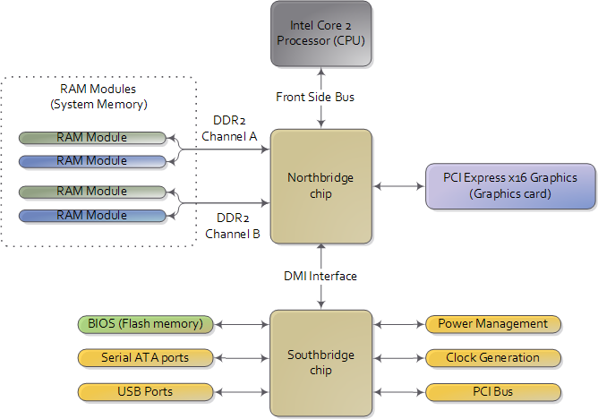
Notes:
DMI (direct media interface)

Slide 21
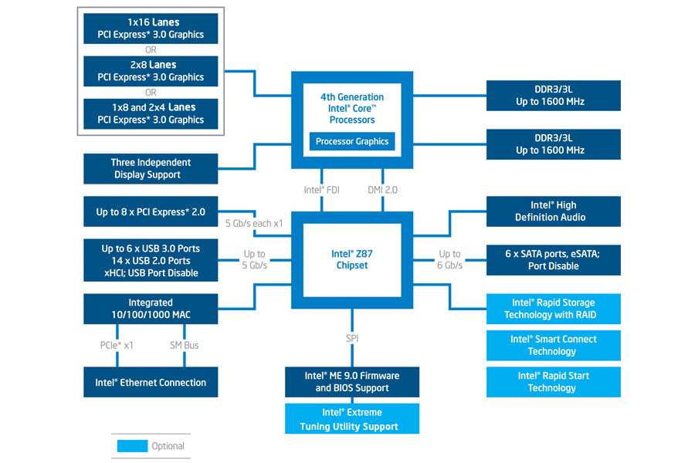
System-on-a-chip (SoC)
www.intel.com (2013)

Slide 22
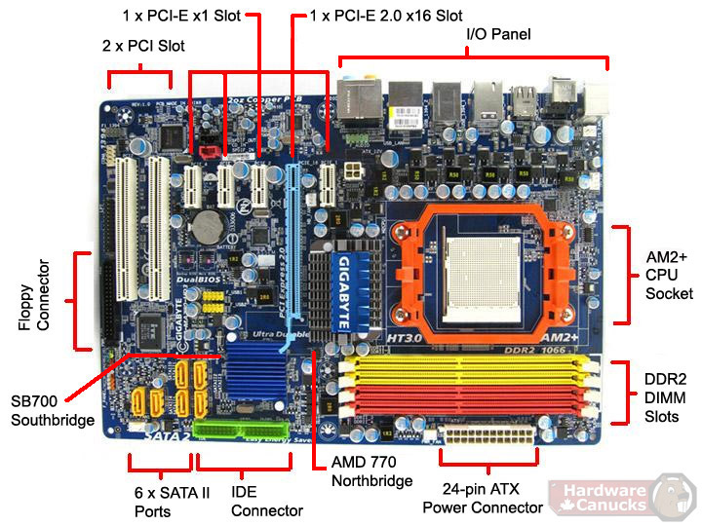
www.hardwarecanucks.com, July 2009

Slide 23
4 Representing data and instructions inside a computer

Slide 24
Representing data
1 byte = ? Bits
2 bits can represent how many items?
8 bits can represent how many items? (can you pronounce it)
x to the power of y = x to the yth (power)
X² = X squared
X³ = X cubed
Notes:
1 byte = 8 bits
2 to the power of 8

Slide 25
Printout
No electronic devices for the mid-term & final exams
2an_introduction_to_data_and_information_printable.pdf
Will be discussing sections 2 & 3
3representing_and_manipulating_data_in_computers_printable
Will be discussing section 4 & 5 (other sections might appear in the mid-term)

